Slide 1
WELCOME
30th Annual
Convention & Trade Show
#NARPM2018

Slide 2
#NARPM2018

Slide 3
Fuel Trust & Employee Engagement with Authentic Communication
Carletta Clyatt
Omnia Group

Slide 4
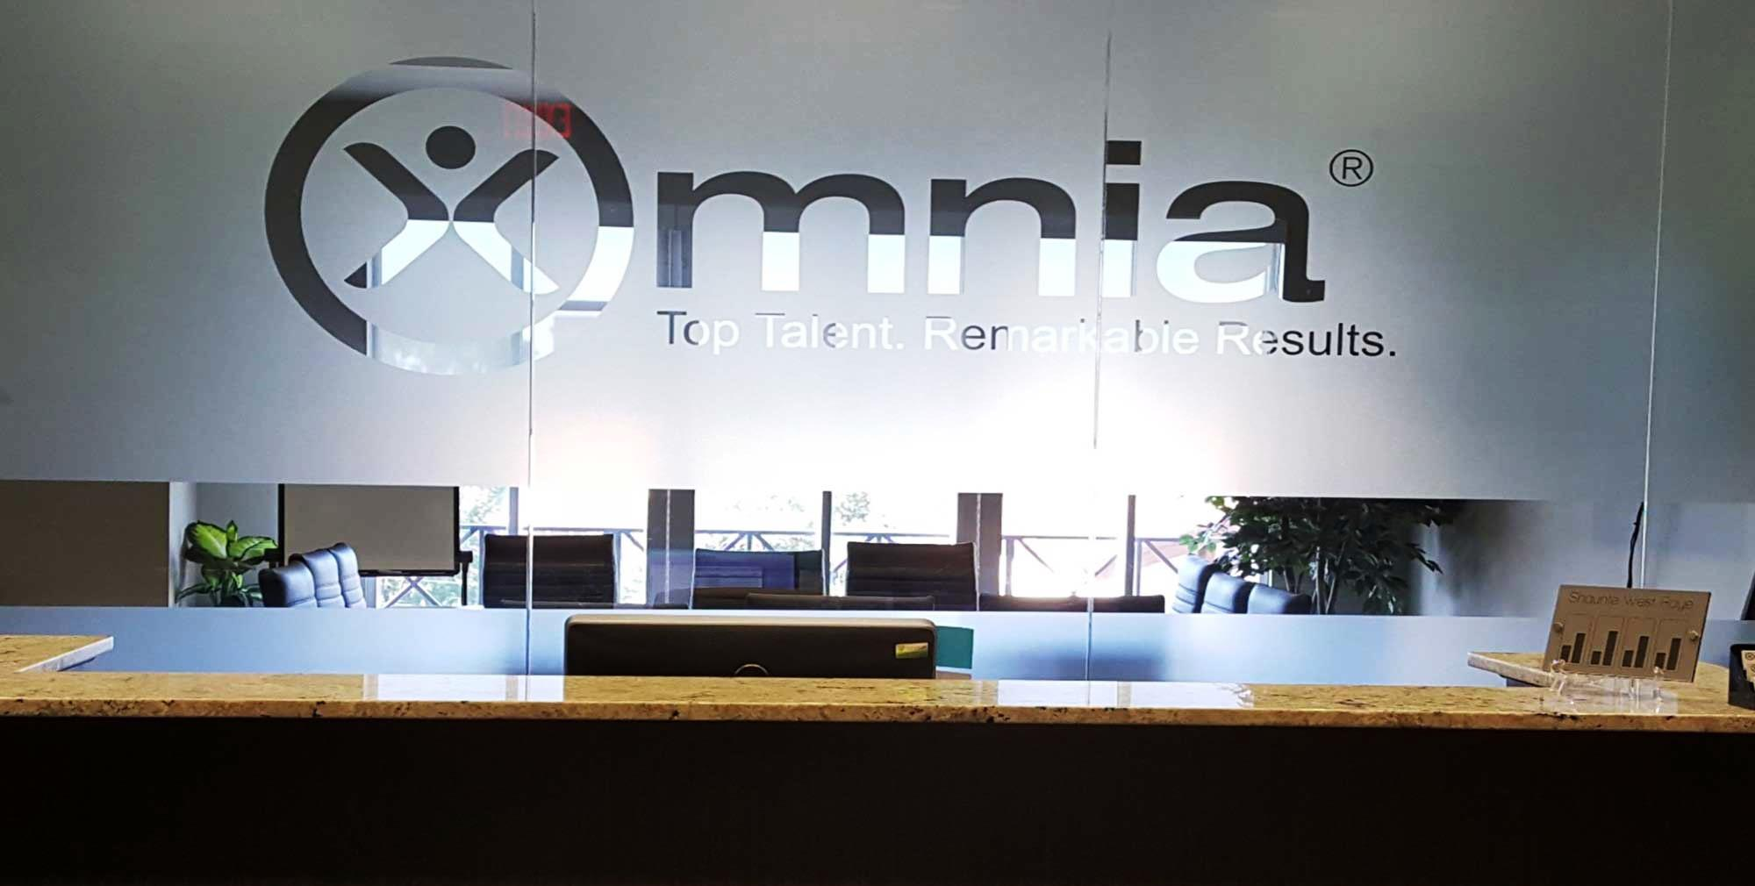
Established in 1985
Validated behavior-based, selection and management tools, and reports
Over 1.3 million behavioral profiles processed
3,500 active clients worldwide

Slide 5
9 Days in…

Slide 6
90 Days in…

Slide 8
Obstacles
Structural
Emotional

Slide 9
Components of Authentic Communication
Transparency
Active listening
Self-awareness

Slide 10
How to Increase Transparency
Create effective avenues for feedback
View mistakes as learning opportunities
Walk the walk
Benefits of Transparency
Builds trust
Better performance
Problem-solving is easier

Slide 11
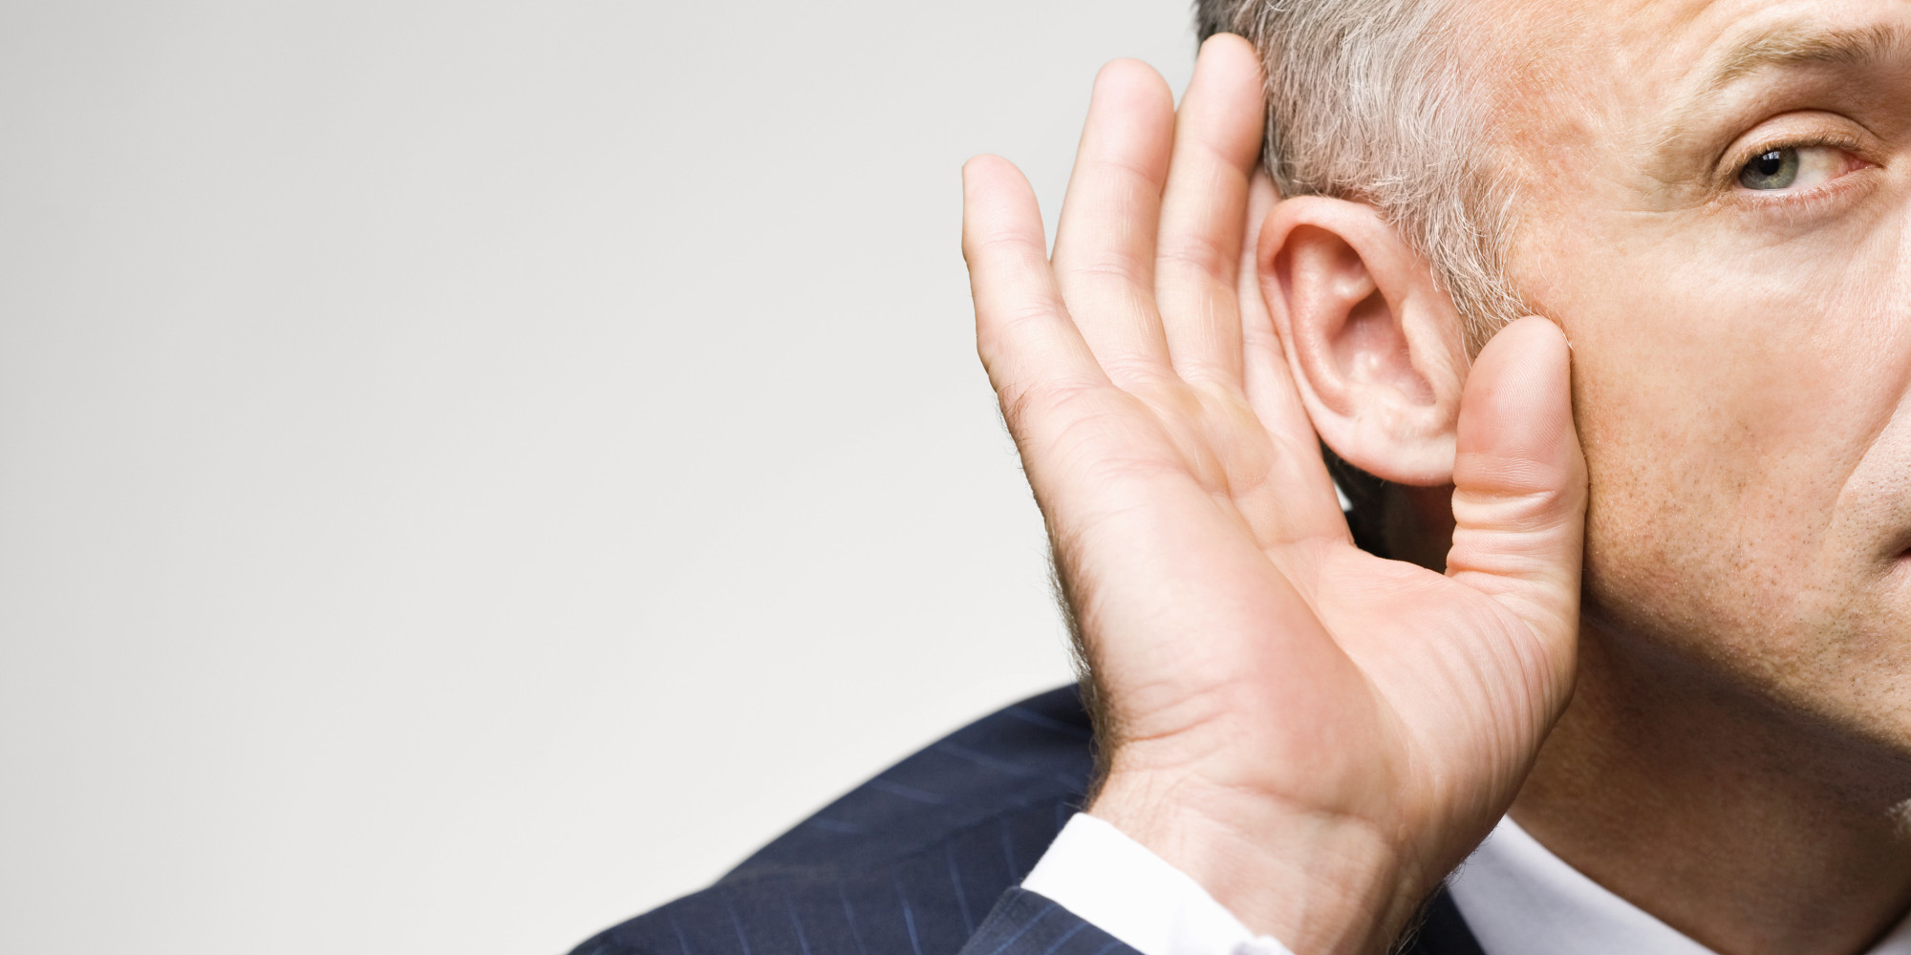
How to Increase Active Listening
Ask questions
Look for nonverbal cues
Be attentive, but relaxed
Summarize, summarize, summarize
Benefits of Active Listening
Enhances motivation
Overcomes resistance
Saves time and money

Slide 12
How to Become Self Aware
Know yourself
Feedback
Benefits of Self Awareness
Ability to adapt
Better decision making
Play to your strengths

Slide 13
Emotional Mind
Intellectual Mind
Characteristics
Focus on feeling
Focus on people
Challenges
Viewed as “drama”
Strengths
Empathetic
Characteristics
Focus on facts
Focus on process
Challenges
Viewed as impersonal
Strengths
Objective

Slide 14
What’s Your Communication Style?
The Persistent Leader
The Administrator
The Entrepreneur
The Diplomat
The Operations Leader
The Technician
The Promoter
The Pragmatic Leader
The Assertive Technician
The Counselor Advisor
The Accommodator
The Assertive Administrator
The Networker
The Assertive Diplomat
The Bureaucrat
The Persistent Entrepreneur

Slide 15
Assertiveness
Highly Assertive
Take charge
Goal driven
Aggressive
Supportive
Supportive
Reserved
Risk avoidant

Slide 16
Communication Styles
Relational
Consultative
Animated
Entertaining
Expressive
Direct
Practical
Analytical

Slide 17
Engaging an Expressive Communicator
Mix it up
Give them an opportunity to speak
Just because they make jokes doesn’t mean treat them like one

Slide 18
Engaging a Consultative Communicator
Give advance warning
Give time for relationships to form
Use written communication when available

Slide 19
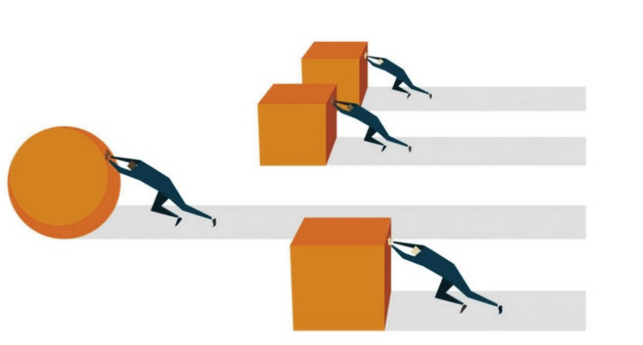
Pace and Adaptability
Time Driven
Quick paced
Flexible
Multi-tasker
Process Driven
Methodical
Task focused
Routine oriented

Slide 20
Obstacles to Authentic Communication
Structural
Emotional

Slide 21
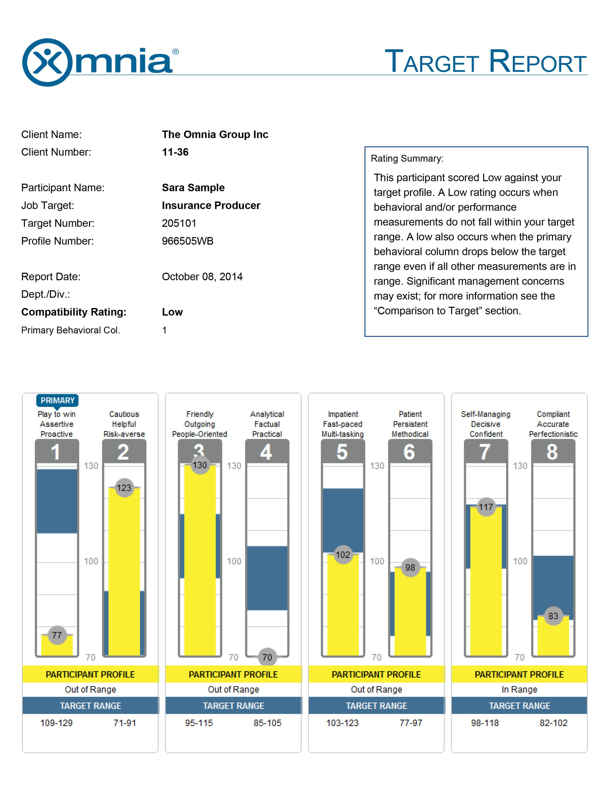
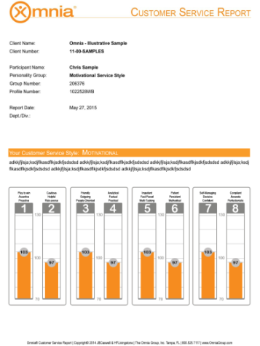
Omnia’s Suite of Reports

Slide 22
Questions?

Slide 23
Fuel Trust and Employee Engagement with Authentic Communication
For more information:
Carletta Clyatt, Senior Vice President
800.525.7117 Ext. 1226
Carletta@OmniaGroup.com
OmniaGroup.com

